Slide 1
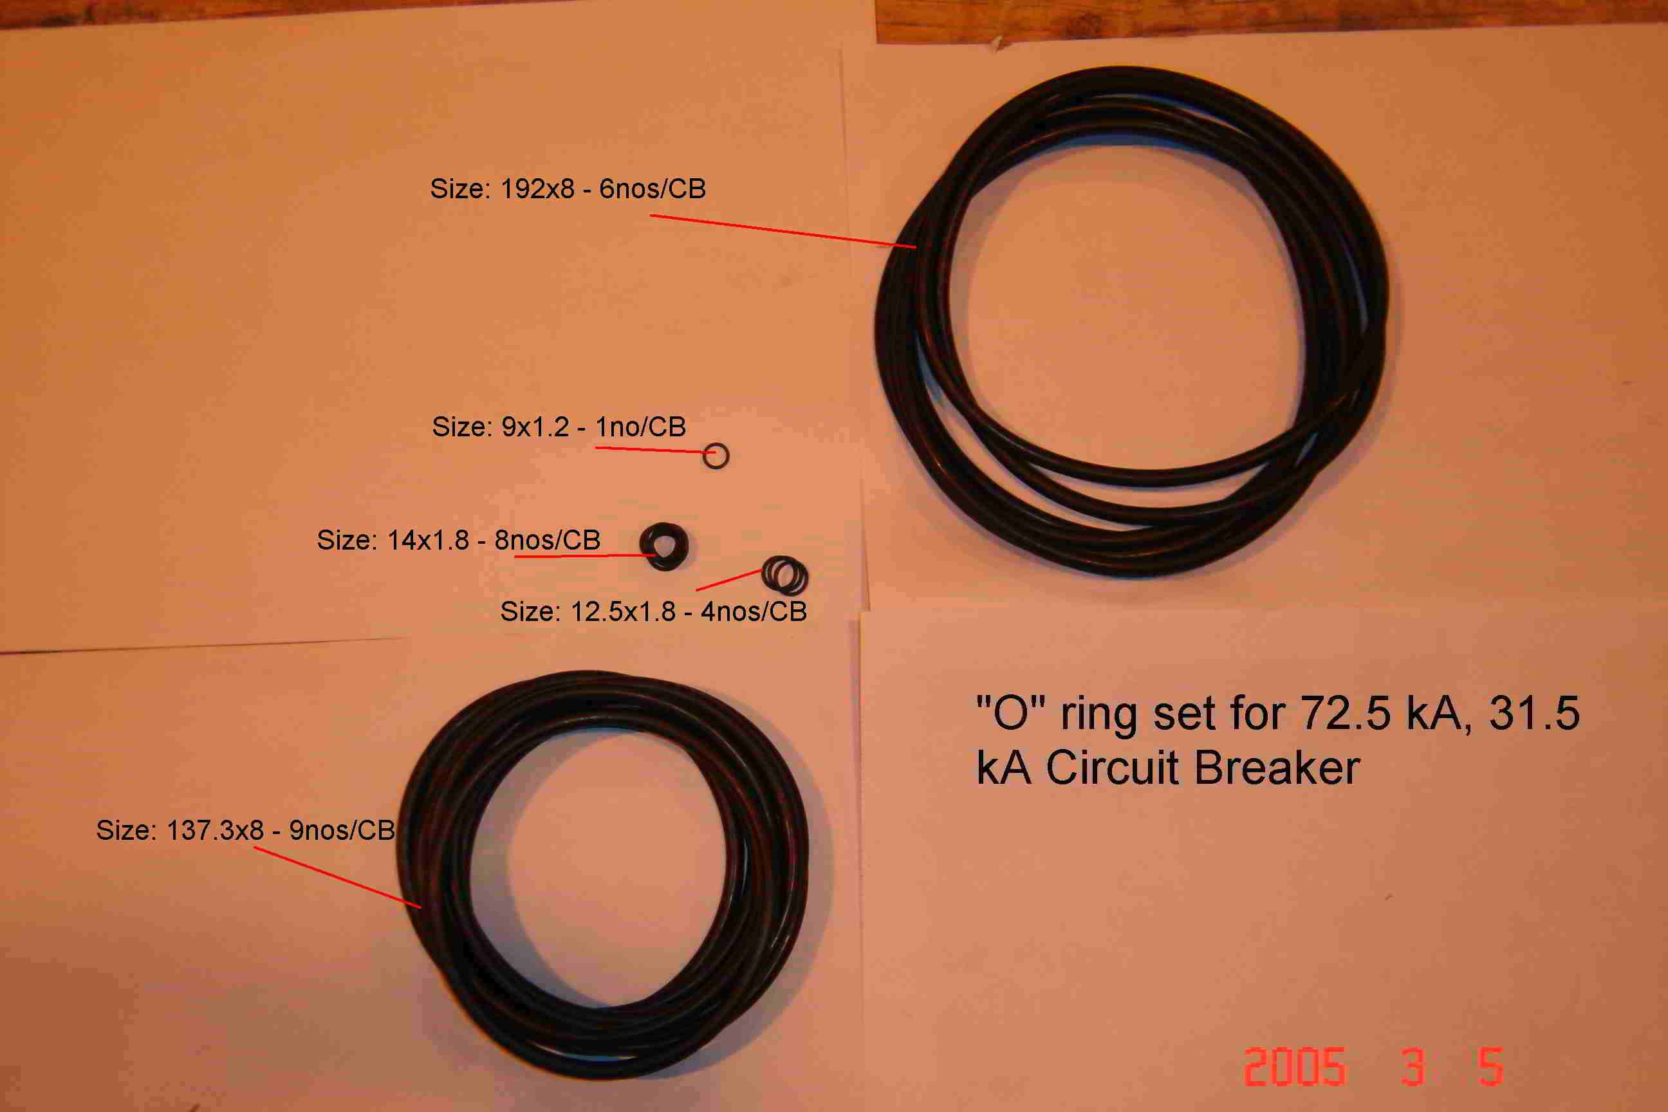
SIEMENS
HVCB SPARES
“O” rings set for complete 72.5KV, 31.5KA CB
S4799244301

